Slide 1
Managing Data Resources
Laudon & Laudon
PowerPoint by Daniel Obuobi

Slide 2
Management Opportunities, Challenges, and Solutions
Organizational performance can be improved by making better use of firm data, improving data, and using techniques such as data mining.
Challenges to managing data effectively include organizational obstacles to a database environment and cost/benefit considerations.
Critical elements for creating a database environment are
  (1) data administration,
  (2) data planning and modeling methodology,
  (3) database technology and management, and
  (4) users. [Figure 7-18]

Slide 3
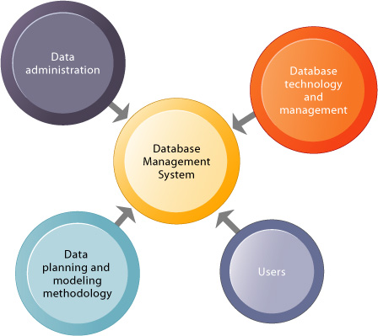
Key organizational elements in the database environment
FIGURE 7-18 Key organizational elements in the database environment
For a database management system to flourish in any organization, data administration functions and data-planning and modeling methodologies must be coordinated with database technology and management.
Resources must be devoted to train end users to use databases properly.

Slide 4
Database systems
Database systems require that an organization recognize the strategic role of information and actively manage and plan for information as a corporate resource.
The organization must develop a data administration function with the power to define information requirements for the entire company and with direct access to senior management.
The fundamental principle of data administration is that all data are the property of the organization; therefore all data are to be made available to any group that requires them.
An organization should formulate an information policy that specifies rules and procedures for acquiring, inventorying, and distributing data.

Slide 5
Database systems (2)
The other critical elements of a successful database environment are a data planning and modeling methodology; database technology and management; and users.
Because a database serves a wider community of users than traditional systems, organizations must devote more resources to training end users.
Professional systems workers must be retrained in the DBMS language, DBMS application development procedures, and new software practices.
Most corporations need a specialized database design and management group to develop and maintain their databases.
Its functions are called database administration.

Slide 6
Organizing Data in a Traditional File Environment
Computer systems organize data in a hierarchy that begins with bits and bytes and progresses to
  fields,
  records, files, and
  databases
[Figure 7-1].

Slide 7
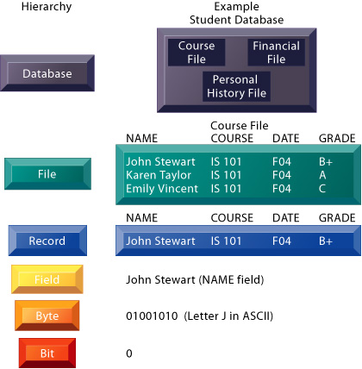
The data hierarchy
FIGURE 7-1 The data hierarchy
A computer system organizes data in a hierarchy that starts with the bit, which represents either a 0 or a 1.
Bits can be grouped to form a byte to represent one character, number, or symbol.
Bytes can be grouped to form a field, and related fields can be grouped to form a record.
Related records can be collected to form a file, and related files can be organized into a database.

Slide 8
Definitions
A field is a grouping of characters into a word, group of words, or complete number.
A record consists of a group of related fields, and a file is a group of the same type of records.
A person, place, or thing about which information must be kept is called an entity.
An attribute is a piece of information about a particular entity, and a key field is a field in a record that uniquely identifies instances of that record so that it can be retrieved or updated. [Figure 7-2]

Slide 9
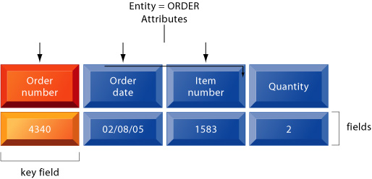
Entities and attributes
Figure 7-2: Entities and attributes
This record describes the entity called ORDER and its attributes.
The specific values for Order number, Order date, Item number, and Quantity for this particular order are an instance of the entity ORDER and represent the fields for this particular record.
Order number is the key field because each order is assigned a unique identification number.

Slide 10
Problem with traditional file systems
Despite the use of excellent hardware and software, many organizations have inefficient information systems because of poor file management.
By allowing different functional areas in the organization to maintain their files independently, the traditional file environment creates problems such as
  data redundancy and inconsistency,
  program-data dependence,
  inflexibility,
  poor security, and
  lack of data sharing and availability. [Figure 7-3]

Slide 11
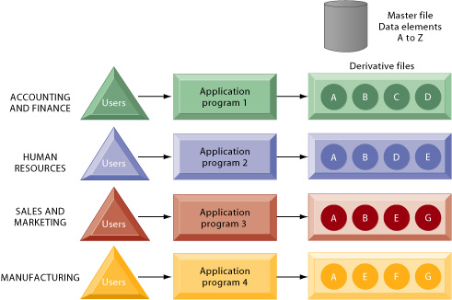
Traditional file processing
Figure 7-3: Traditional file processing
The use of a traditional approach to file processing encourages each functional area in a corporation to develop specialized applications.
Each application requires a unique data file that is likely to be a subset of the master file.
These subsets of the master file lead to data redundancy and inconsistency, processing inflexibility, and wasted storage resources.

Slide 12
The Database Approach to Data Management
Database technology eliminates many of the problems of traditional file organization by organizing data so that they can efficiently serve many applications and different groups at the same time.
Instead of storing data in separate files for each application, a database management system (DBMS) allows individual business applications to extract information from a central source without having to create separate files or data definitions in their computer programs. [Figure 7-4]

Slide 13
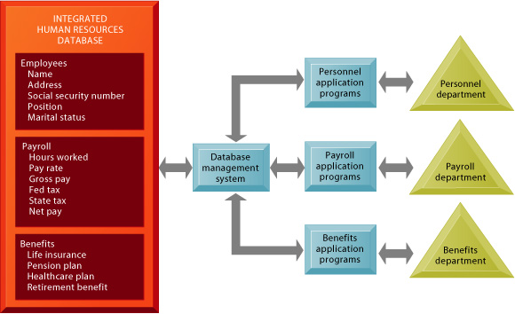
The contemporary database environment
Figure 7-4: The contemporary database environment
A single human resources database serves multiple applications and also enables a corporation to easily draw together all the information for various applications.
The database management system acts as the interface between the application programs and the data.

Slide 14
database management system
A DBMS has three components: a data definition language; a data manipulation language; and a data dictionary.
The most important difference between a DBMS and traditional file organization is that the DBMS separates the logical and physical views of data, relieving the programmer or end user from the task of understanding where and how the data are actually stored.

Slide 15
The logical view
The logical view presents data as they would be seen by end users, whereas the physical view shows how data are actually organized and structured on physical storage media.
The logical definition of the entire database showing all the data elements and their relationships is called the conceptual schema.
Structured query language (SQL) is the principal data manipulation language for relational DBMS. [Figure 7-5]

Slide 16
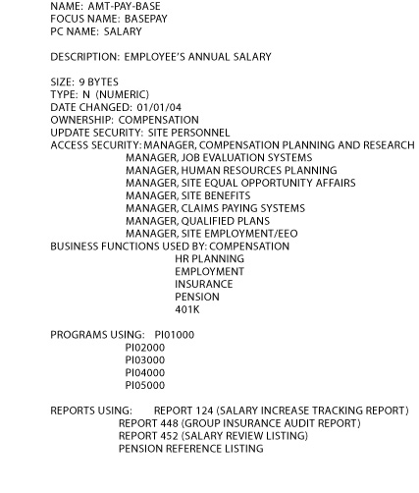
Sample data dictionary report
Figure 7-5: Sample data dictionary report
The sample data dictionary report for a human resources database provides helpful information, such as the size of the data element, which programs and reports use it, and which group in the organization is the owner responsible for maintaining it.
The report also shows some of the other names that the organization uses for this piece of data.

Slide 17
Benefits of DBMS
A DBMS can simplify an organization's information system environment by providing central management of data, access, utilization, and security.
Data redundancy and inconsistency can be reduced by eliminating all of the isolated files in which the same data elements are repeated.
Data confusion can be eliminated by providing central control of data creation and definitions.

Slide 18
Benefits of DBMS (2)
Program-data dependence can be reduced by separating the logical view of data from the physical arrangement of data.
Flexibility of information systems can be greatly enhanced by permitting rapid and inexpensive ad hoc queries of very large pools of information.
Also, with a DBMS, access and availability of information can be significantly increased.

Slide 19
Benefits of DBMS (3)
Conventional DBMS keep track of entities, attributes, and relationships using one of three logical database models:
  relational,
  hierarchical, and
  network and object-oriented.
Each logical model has certain processing advantages and disadvantages.

Slide 20
relational database model
The relational database model represents data as two-dimensional tables called relations and can depict many-to-many relationships.
It can relate data stored in one table to data in another as long as the two tables share a common data element.
Relational DBMS provide greater flexibility than the other database models in regard to ad hoc queries, power to combine information from different sources, simplicity of design and maintenance, and the ability to add new data and records without disturbing existing programs.
The three basic operations in a relational database are select, project, and join. [Figure 7-6, Figure 7-7]

Slide 21
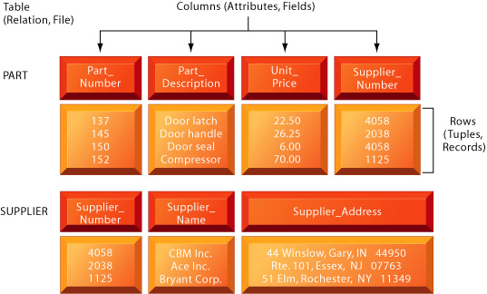
The relational data model
Figure 7-6: The relational data model
Each table is a relation, each row is a tuple representing a record, and each column is an attribute representing a field. These relations can easily be combined and extracted to access data and produce reports, provided that any two share a common data element. In this example, the PART and SUPPLIER files share the data element Supplier_Number.

Slide 22
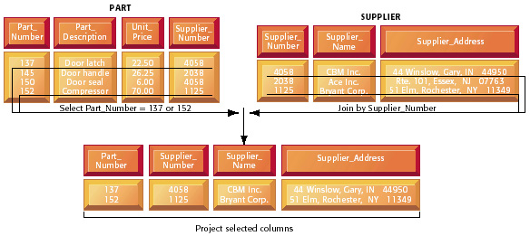
The three basic operations of a relational DBMS
Figure 7-7: The three basic operations of a relational DBMS
The select, project, and join operations allow data from two different tables to be combined and only selected attributes to be displayed.

Slide 23
Hierarchical and network database models
Hierarchical and network database models are extremely efficient at processing large structured routine requests.
The hierarchical database model is useful for depicting one-to-many relationships.
The network database model can depict many-to-many relationships.
However, both network and hierarchical database models lack flexibility and are inappropriate when non-routine or ad hoc information is needed.
Both hierarchical and network systems are programming-intensive, time-consuming, difficult to install, and difficult to fix if design errors occur. [Figure 7-8, Figure 7-9]

Slide 24
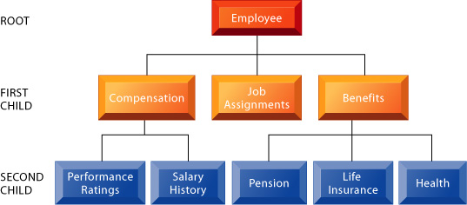
A hierarchical database for a human resources system
Figure 7-8: A hierarchical database for a human resources system
The hierarchical database model looks like an organizational chart or a family tree.
It has a single root segment (Employee) connected to lower level segments (Compensation, Job Assignments, and Benefits).
Each subordinate segment, in turn, may connect to other subordinate segments.
Here, Compensation connects to Performance Ratings and Salary History. Benefits connects to Pension, Life Insurance, and Health.
Each subordinate segment is the child of the segment directly above it.

Slide 25
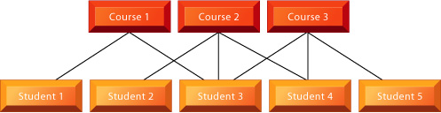
The network data model
Figure 7-9: The network data model
This illustration of a network data model showing the relationship the students in a university have to the courses they take represents an example of logical many-to-many relationships.

Slide 26
Limitation of Conventional DBMS
Conventional DBMS are not well-suited to handling graphics or multimedia applications, object-oriented databases have been developed.
An object-oriented DBMS (OODBMS) stores data and procedures as objects that can be retrieved and shared.
Although OODBMS can store more complex information than relational DBMS, they are relatively slow for processing large numbers of transactions.
Hybrid object-relational DBMS combine the capabilities of both object-oriented and relational DBMS.

Slide 27
Creating a Database Environment
Creating a database involves two design exercises: a conceptual design and a physical design.
The conceptual design of a database is an abstract model of the database from a business perspective.
It can be documented by using an entity-relationship diagram, which illustrates the relationship among the various entities in the database.
The physical design shows how the database is actually arranged on direct-access storage devices.
Logical database designs require both a detailed description of business information requirements as well as the needs of actual end users.
A well-designed relational database does not have redundant data elements or awkward many-to-many relationships among the data.
The process of streamlining complex groups of data to create small stable data structures is called normalization. [Figure 7-10, Figure 7-11, Figure 7-12]

Slide 28

unnormalized relation
FIGURE 7-10 An unnormalized relation for ORDER
An unnormalized relation contains repeating groups. For example, there can be many parts and suppliers for each order.
There is only a one-to-one correspondence between Order_Number, Order_Date, and Delivery_Date.

Slide 29
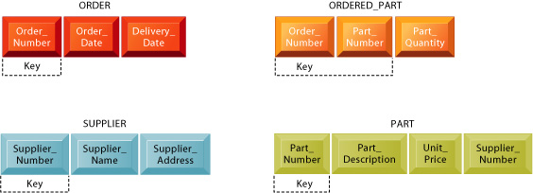
Normalized tables
FIGURE 7-11 Normalized tables created from ORDER
After normalization, the original relation ORDER has been broken down into four smaller relations.
The relation ORDER is left with only three attributes and the relation ORDERED_PART has a combined, or concatenated, key consisting of Order_Number and Part_Number.

Slide 30
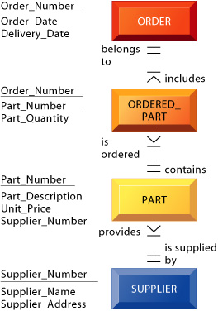
An entity-relationship diagram
FIGURE 7-12 An entity-relationship diagram
This diagram shows the relationships between the entities ORDER, ORDERED_PART, PART, and SUPPLIER that might be used to model the database in Figure 7-11.

Slide 31
Centralized and distributed DB
Database design also considers whether data are to be centralized or distributed.
A distributed database is one in which parts of copies of the database are physically stored in one location and other parts or copies are stored and maintained in other locations.
The two major types of distributed databases are replicated databases and partitioned databases. [Figure 7-13]

Slide 32
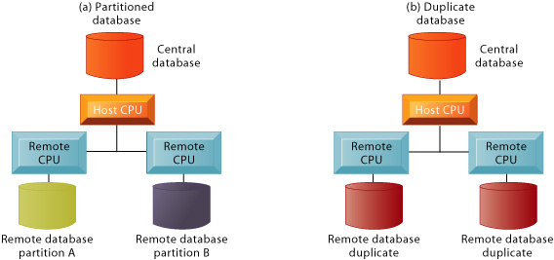
Distributed databases
Figure 7-13 Distributed databases
There are alternative ways of distributing a database.
The central database can be partitioned (a) so that each remote processor has the necessary data to serve its own local needs.
The central database also can be replicated (b) at all remote locations.

Slide 33
Good DB
A good database design also includes efforts to maximize data quality and eliminate error.
Some data quality problems result from redundant and inconsistent data, but most stem from errors in data input.
Organizations need to identify and correct faulty data and establish better routines for input and editing.
A data quality audit can be performed by surveying entire data files, sample data, and surveying end-users impressions of data quality.
Data cleansing (or data scrubbing) techniques can be used to correct data and enforce consistency among different sets of data.

Slide 34
Database Trends
Organizations are installing powerful data analysis tools and data warehouses to make better use of the information stored in their databases and are taking advantage of database, technology linked to the World Wide Web.
Multidimensional data analysis enables users to view the same data in different ways using multiple dimensions.
Each aspect of information, such as product, pricing, cost, region, or time period, would represent a different dimension.
Using multidimensional data analysis, such dimensions could be visualized as cubes, with each side of the cube representing a different dimension of data.
Another name for multidimensional data analysis is on-line analytical processing (OLAP). [Figure 7-14]

Slide 35
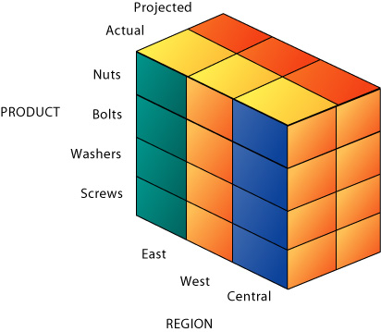
Multidimensional data model.
Figure 7-14 Multidimensional data model.
The view that is showing is product versus region.
If you rotate the cube 90 degrees, the face that will be showing is product versus actual and projected sales.
If you rotate the cube 90 degrees again, you can see region versus actual and projected sales.
Other views are possible.
The ability to rotate the data cube is the main technique for multidimensional reporting.
It is sometimes called “slice and dice.”

Slide 36
data warehouse
A data warehouse is a database with tools that stores current and historical data of interest to managers.
The data are consolidated and organized so that they can be used for management analysis and decision-making across the enterprise. [Figure 7-15]

Slide 37
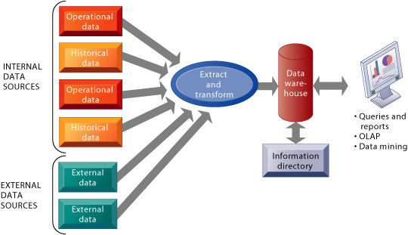
Components of a data warehouse
FIGURE 7-15 Components of a data warehouse
A data warehouse extracts current and historical data from operational systems inside the organization.
These data are combined with data from external sources and reorganized into a central database designed for management reporting and analysis.
The information directory provides users with information about the data available in the warehouse.

Slide 38
Datamining
Datamining analyzes large pools of data, including the contents of data warehouses, in order to find patterns and rules that can be used to predict future behavior and guide decision-making.

Slide 39
hypermedia database
The hypermedia database approach to data management organizes data as a network of nodes linked in any pattern established by the user.
The nodes can contain text, graphics, sound, full-motion video, or executable programs.
Web sites use hypermedia databases to store information as interconnected pages containing text, sound, video, and graphics. [Figure 7-16]

Slide 40
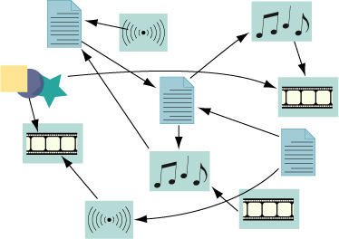
hypermedia database
FIGURE 7-16 A hypermedia database
In a hypermedia database, users can choose their own paths to move from node to node.
Each node can contain text, graphics, sound, full-motion video, or executable programs.

Slide 41
Linking DB to Web
Databases can be linked to the Web by using middleware software products, allowing users to access corporate data through a Web browser interface.
Such software might consist of an application server, a custom software program, or a series of software scripts.
In a client/server environment, the DBMS might reside on a special dedicated computer called a database server. [Figure 7-17]

Slide 42
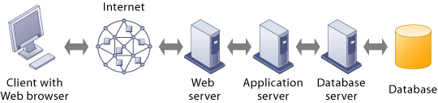
Linking internal databases to the Web
FIGURE 7-17 Linking internal databases to the Web
Users can access an organization’s internal database through the Web using their desktop PCs and Web browser software.

Slide 43
End of Chapter 7
Chapter 11 next

